Slide 1
Applied Business Strategy Challenge – Day 4
Fraud Detection
&
Revenue Protection
December 04, 2025

Slide 2
Applied Business Strategy Challenge – Day 4
Business Problem
Problem: Fraud attacks continue to evolve, increasing operational losses and impacting customer trust. Only 0.17% of transactions are fraudulent, making detection extremely difficult.
What I Did: Built a fraud detection pipeline using Logistic Regression, Random Forest, and Threshold Tuning to improve identification of high-risk transactions.
Why it Matters: Direct financial losses from unauthorized transactions Chargeback fees → $25–$40 per dispute Increased capital requirements for “Expected Loss” Customer dissatisfaction → card closure risk Higher operational workload (manual review teams)

Slide 3
Applied Business Strategy Challenge – Day 4
Data Overview
•
Data Used
Models Built
Why this Approach
284,807 transactions
30 anonymized PCA features
Time of transaction
Transaction amount
Fraud label (Class)
Logistic Regression (baseline)
Random Forest (feature importance)
Threshold tuning for imbalanced detection
Isolation Forest (unsupervised anomaly detection)
Works well with highly imbalanced datasets
Models provide interpretability and business alignment
Fast to run and easy to deploy into monitoring pipelines

Slide 4
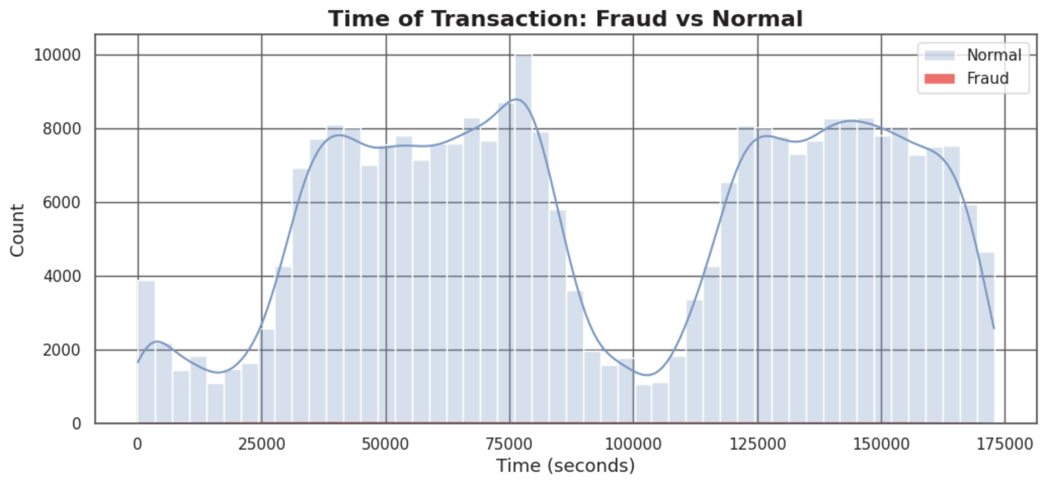
Applied Business Strategy Challenge – Day 4
Exploratory Data Analysis
Key Observations:
Fraud distribution closely overlaps normal transactions → suggests fraud is behaviorally similar, requiring ML instead of simple rules.
No strong correlation between Time and fraud frequency.
Transaction amounts show similar overlap patterns.

Slide 5
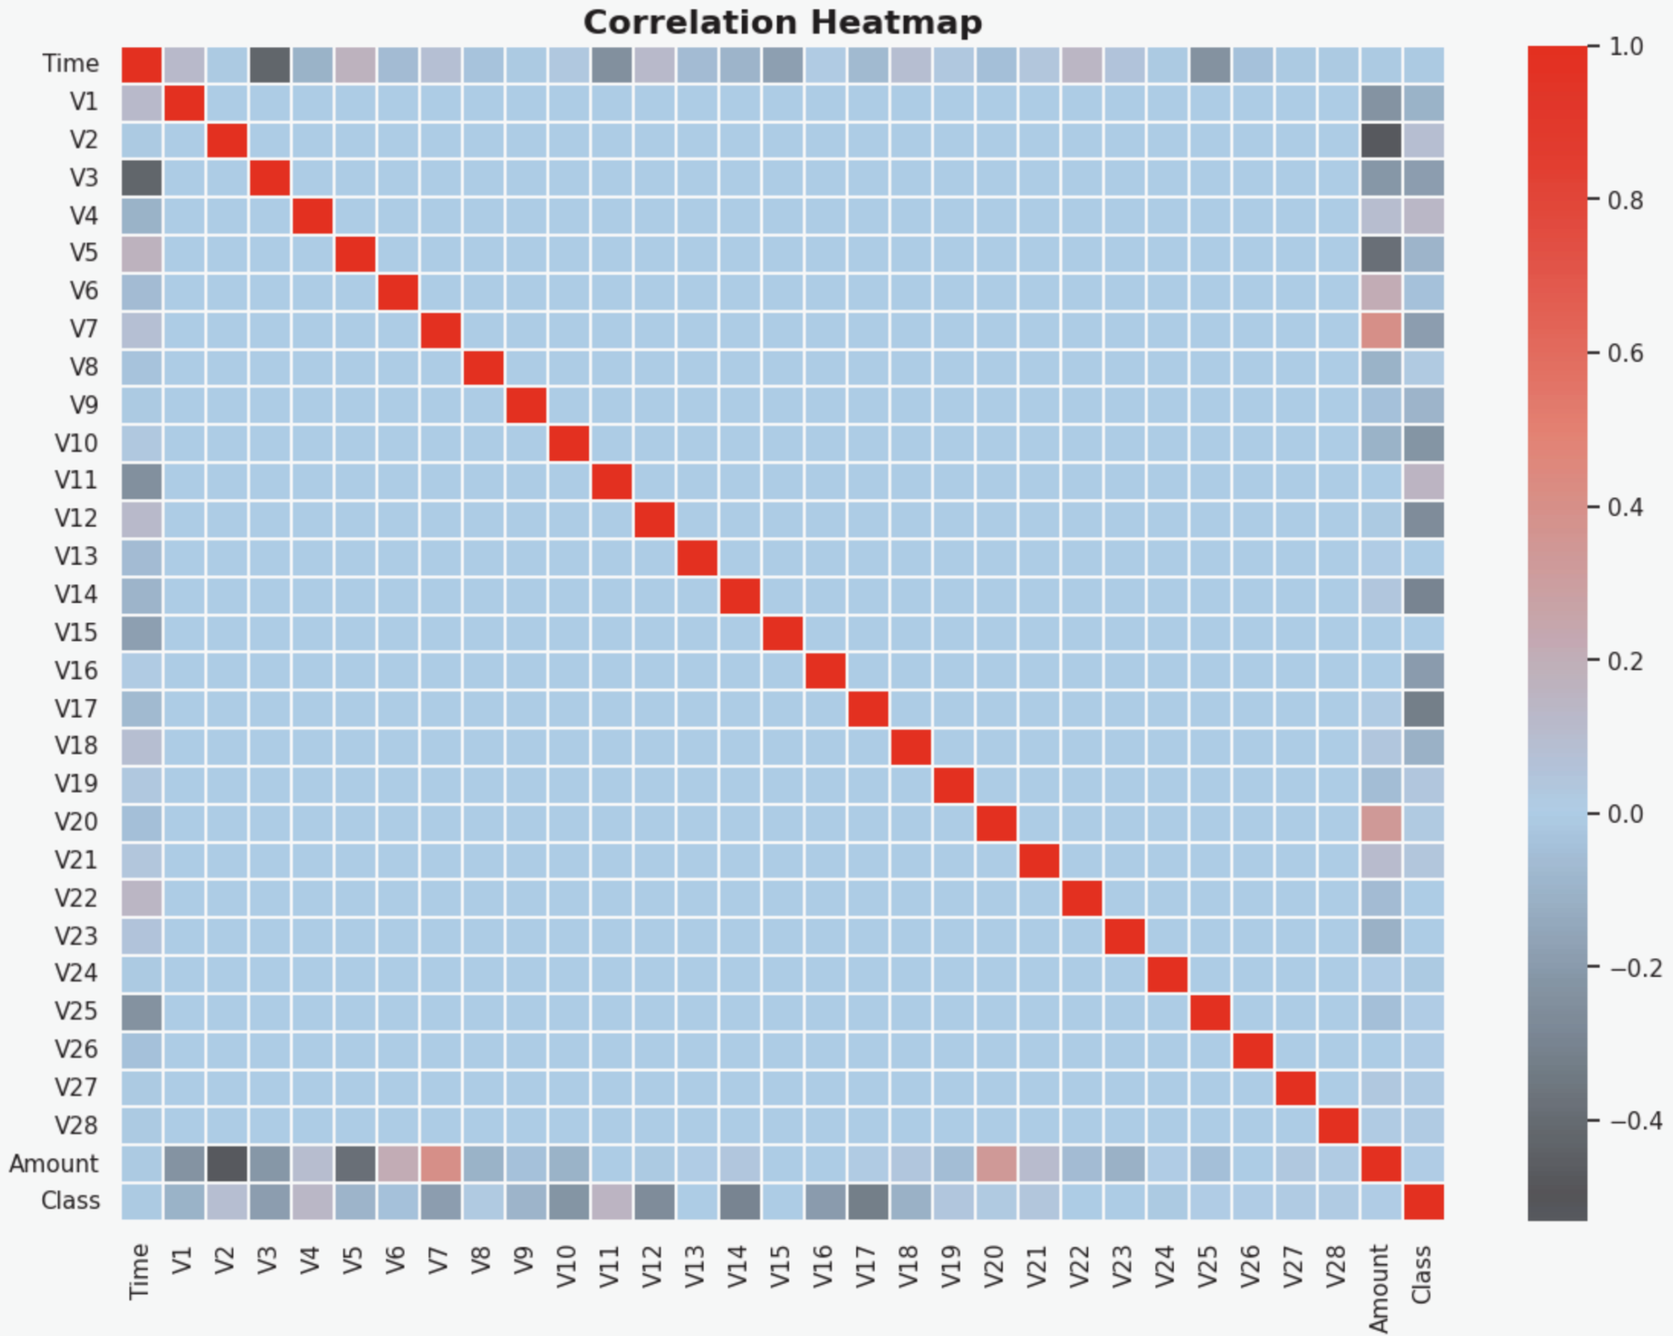
Applied Business Strategy Challenge – Day 4
Correlation Insights
PCA components (V1–V28) show low correlation with each other.
This means each variable captures unique risk signals.
Amount and Time show minimal direct correlation with fraud.
No dominant predictor, reinforces need for ML ensemble approaches.

Slide 6
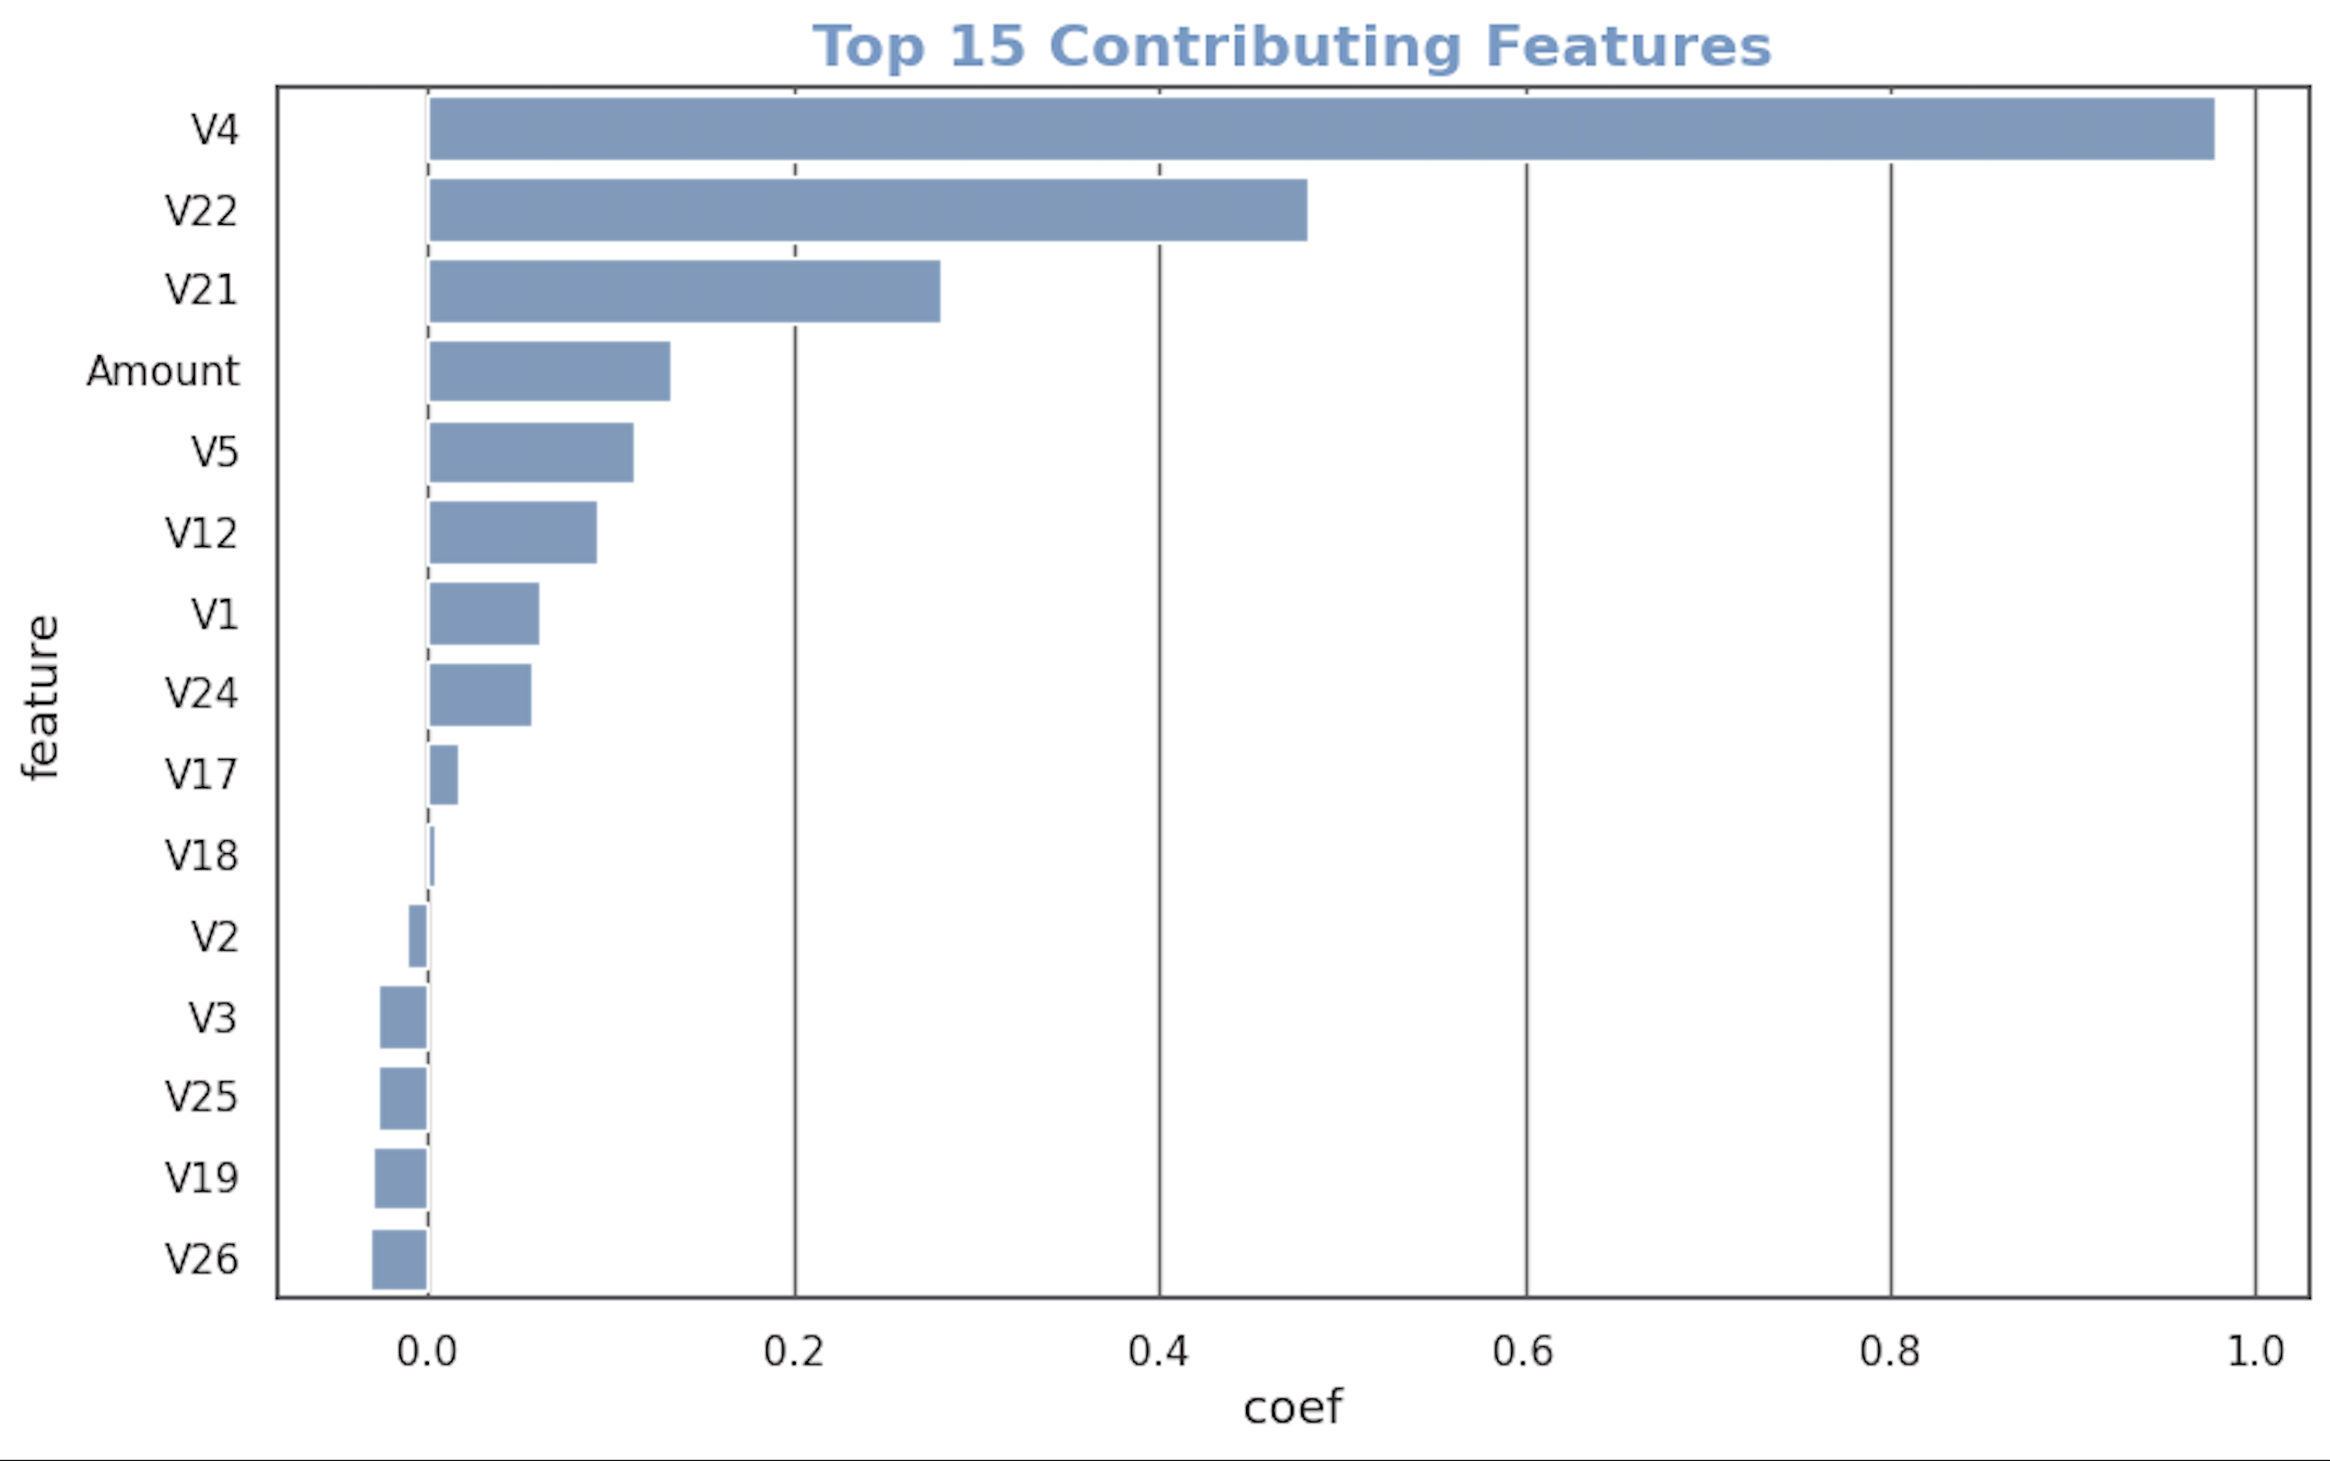
Applied Business Strategy Challenge – Day 4
Feature Contribution
Highlights which signals drive fraud probability.
Enables compliance + model risk review.
Supports explainability requirements.

Slide 7
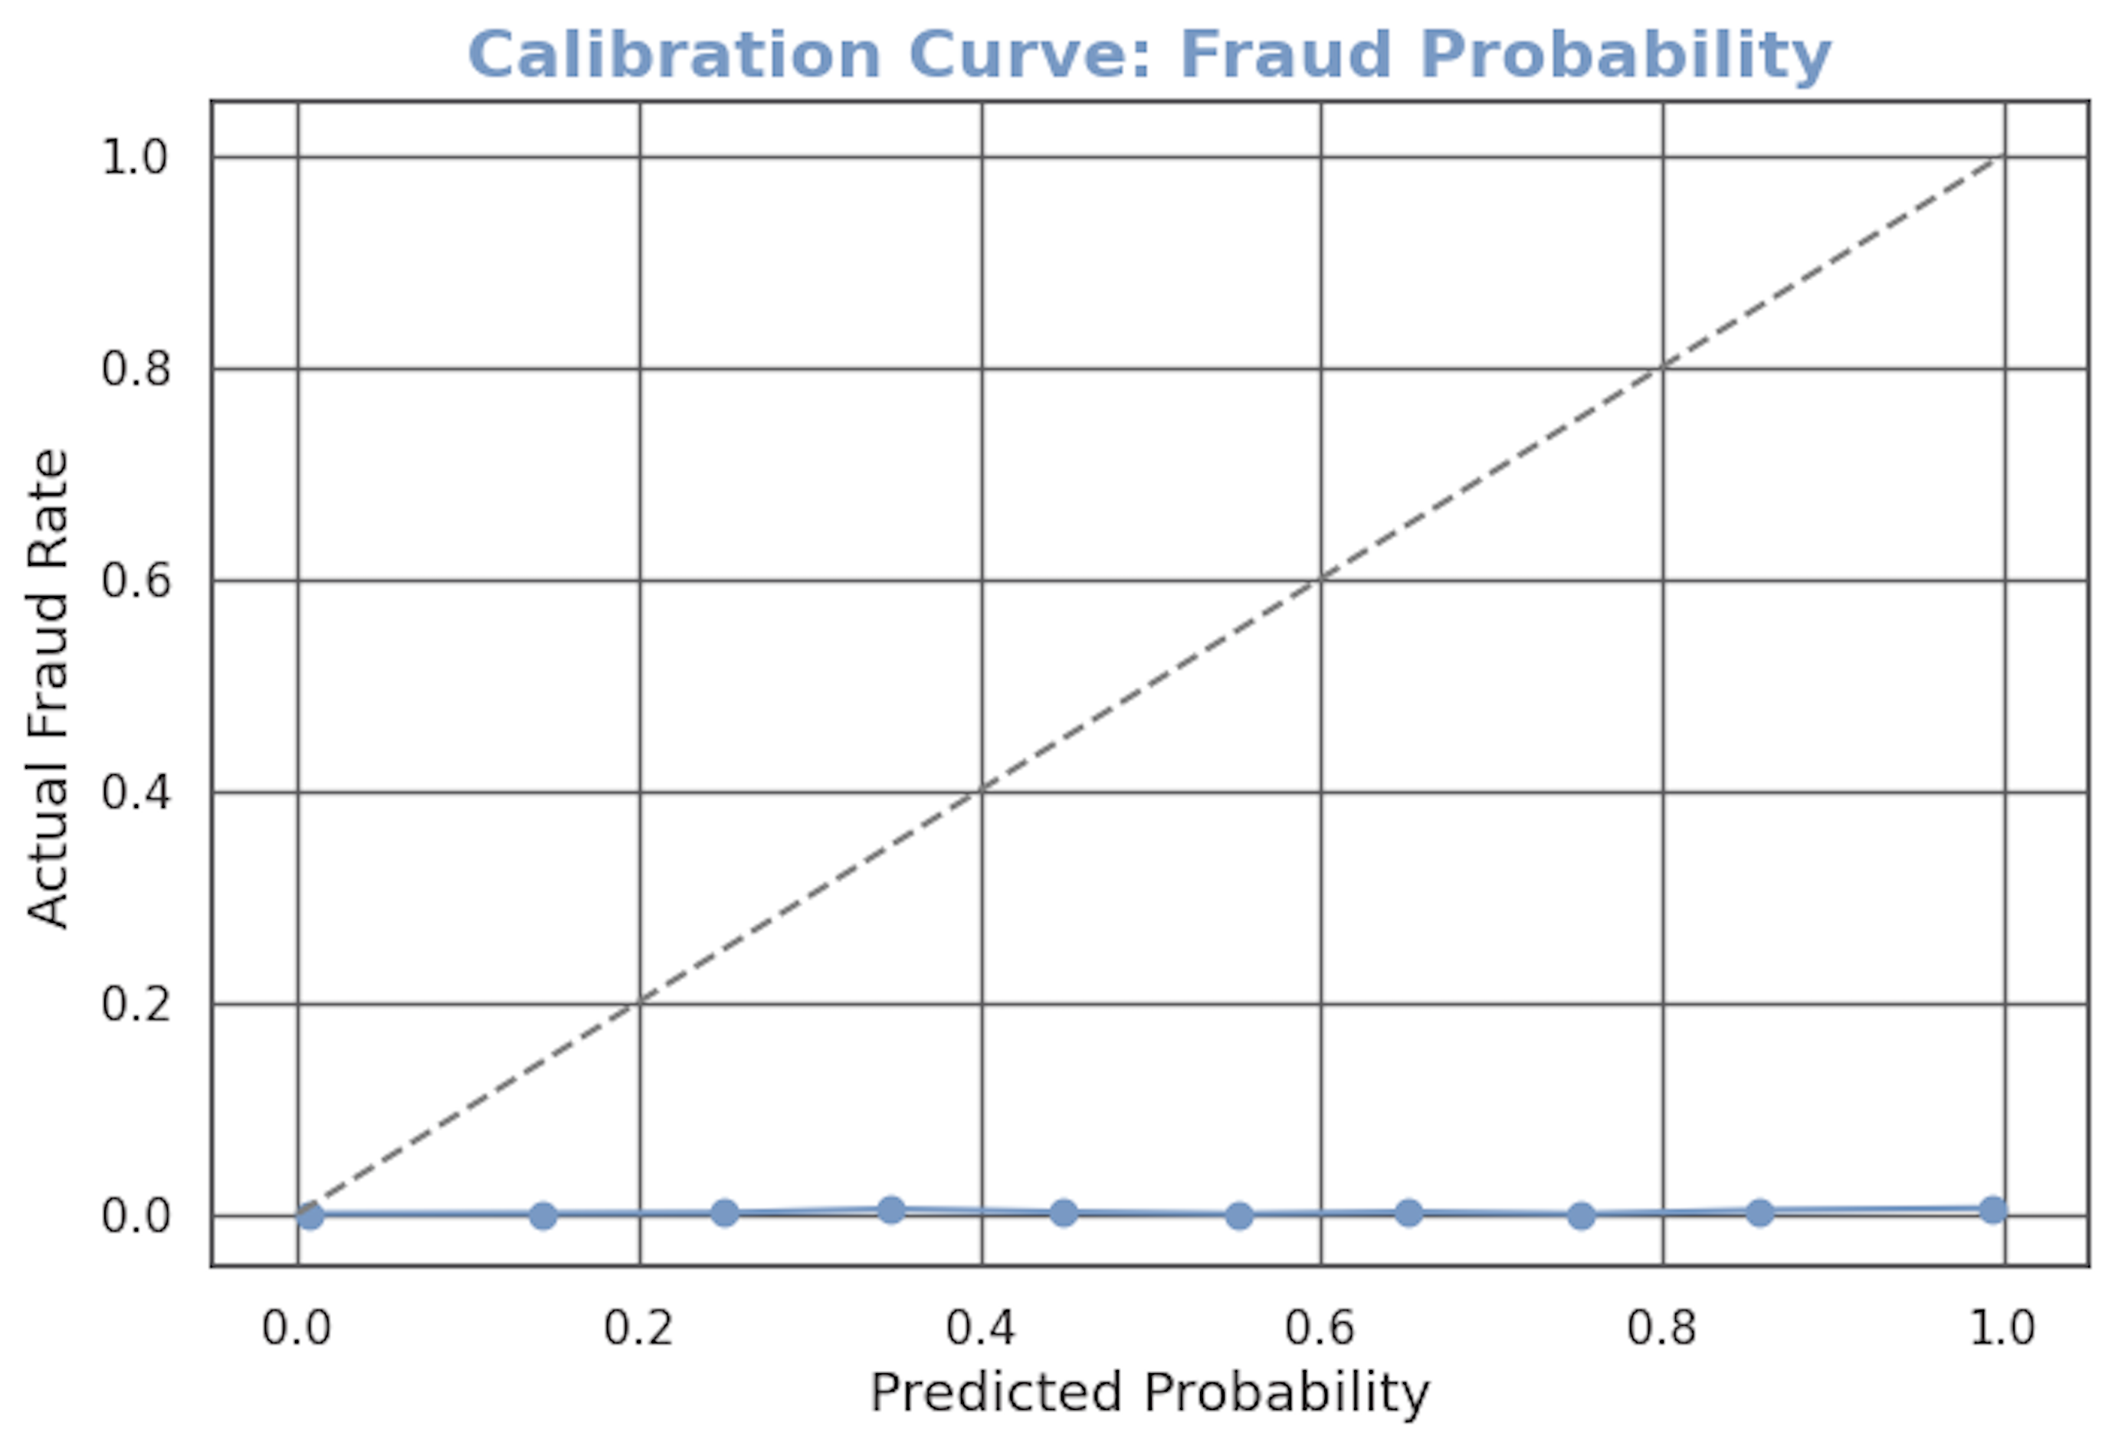
Applied Business Strategy Challenge – Day 4
Fraud Probability
Shows whether fraud probabilities are reliable.
Required for threshold tuning & adaptive risk scoring.
Why important:
Banks must trust scoring probability for provisioning, Basel regulation, risk quantification.

Slide 8
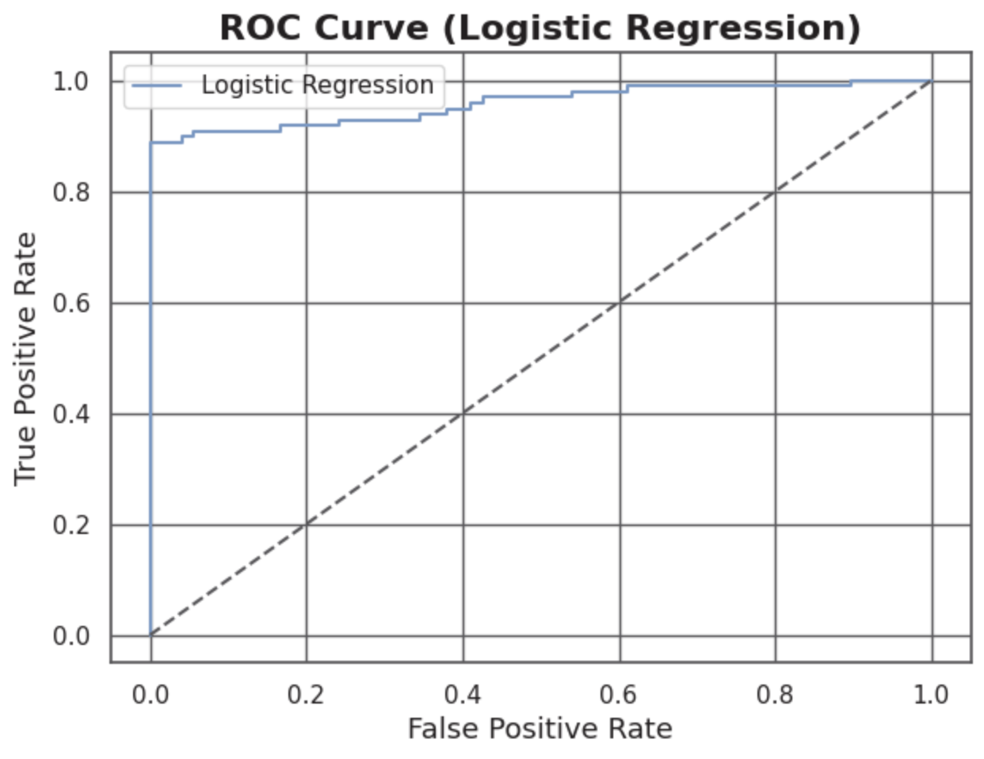
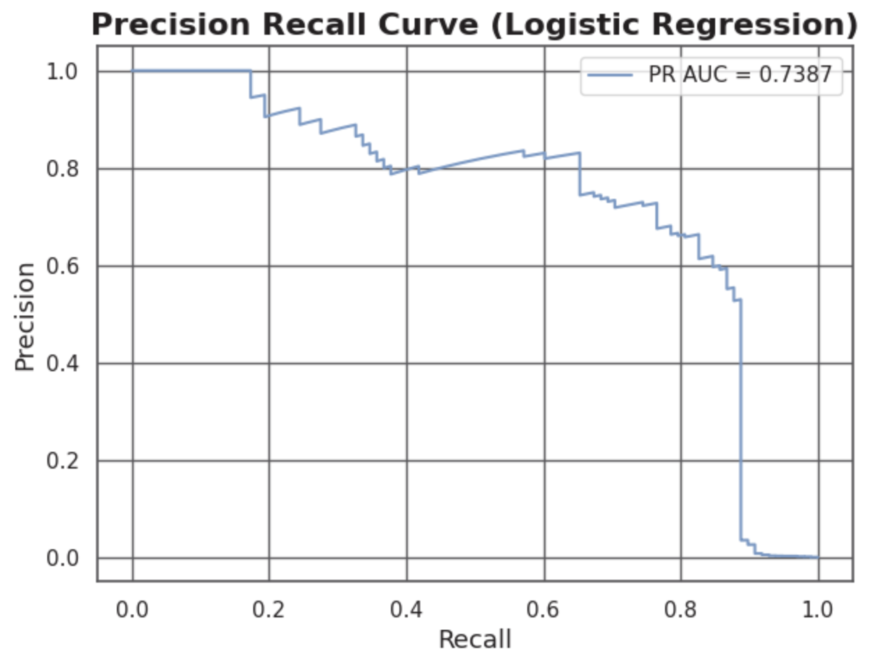
Applied Business Strategy Challenge – Day 4
Fraud Detection Model Performance
Accuracy: 99.92%
Precision: 92.30%
Logistic Regression provided a fast, interpretable baseline.
ROC curve shows strong separation.
Precision-Recall curve highlights the rarity of positive cases, PR is more important than accuracy.
Recall: 82.35%

Slide 9
Applied Business Strategy Challenge – Day 4
Business Interpretation
•
Fraud Behavior Observed
Revenue Impact
Operational Risk
Fraud occurs across many PCA patterns; not isolated
Fraud does not concentrate in time-of-day
Fraud tends to appear in clusters detectable only by ML
Every undetected fraud creates write-offs and higher credit loss provisions
Low precision → false positives disrupt customers
Balanced model reduces support tickets and churn

Slide 10
Applied Business Strategy Challenge – Day 4
How a Program Manager Uses These Insights
Risk Alignment
Monitoring &
Governance
Customer Protection
Align stakeholders
Define fraud SLA
Partner with model risk teams
Track precision-recall drift
Build production dashboards
Reduce false positives
Define escalation workflows

Slide 11
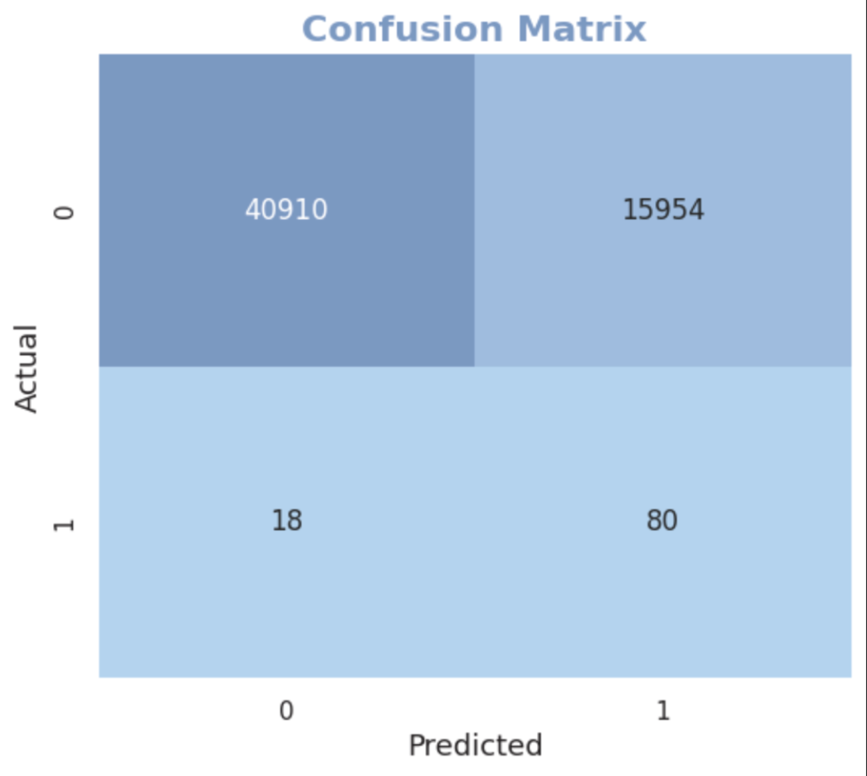
Applied Business Strategy Challenge – Day 4
Strategic Recommendations
Deploy ML-based fraud scoring in real-time
Add fraud probability to every transaction event stream.
2. Introduce adaptive thresholds
Adjust based on volume spikes, time of day, and risk signals.
3. Expand feature engineering
Add merchant category, device fingerprint, geo-location signals.
4. Build human-in-the-loop fraud review
Escalate borderline transactions to risk specialists.

Slide 12
Applied Business Strategy Challenge – Day 4
Final Summary
This project demonstrates how machine learning can reduce fraud losses, strengthen risk management, and protect revenue at scale.
The analysis provides:
Early detection signals.
Actionable risk insights.
PM-level prioritization for mitigation.
Clear next steps toward deployment.

Slide 13
Applied Business Strategy Challenge – Day 4
Thank You!

